Slide 1
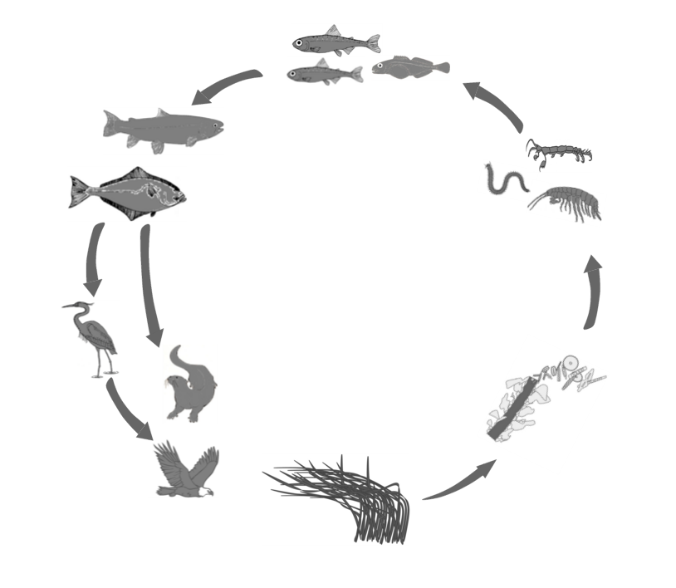
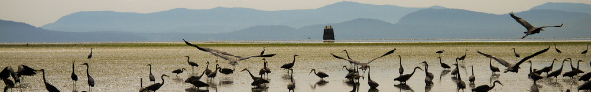
What are the causes and consequences of biodiversity?
Main source of energy and food:
Algae!
Forbes 2015
Notes:
What are the biotic/abiotic factors that influence community structure in seagrass meadow communities from the bottom up and top down?
Valentine and Heck 1993 MEPS 96: 63-74

Slide 2
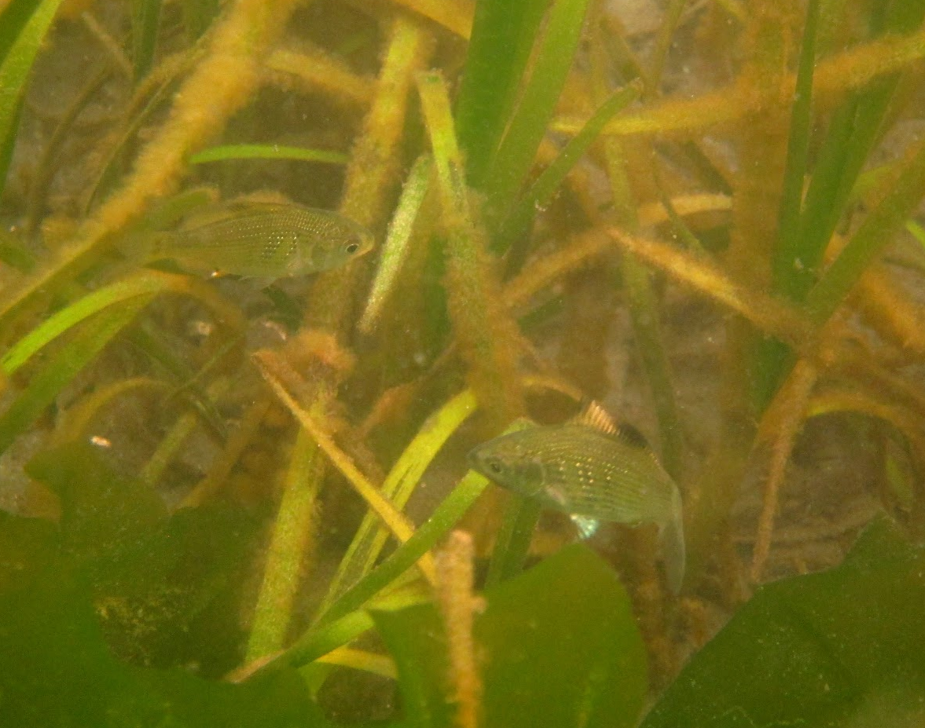
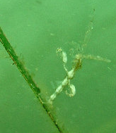
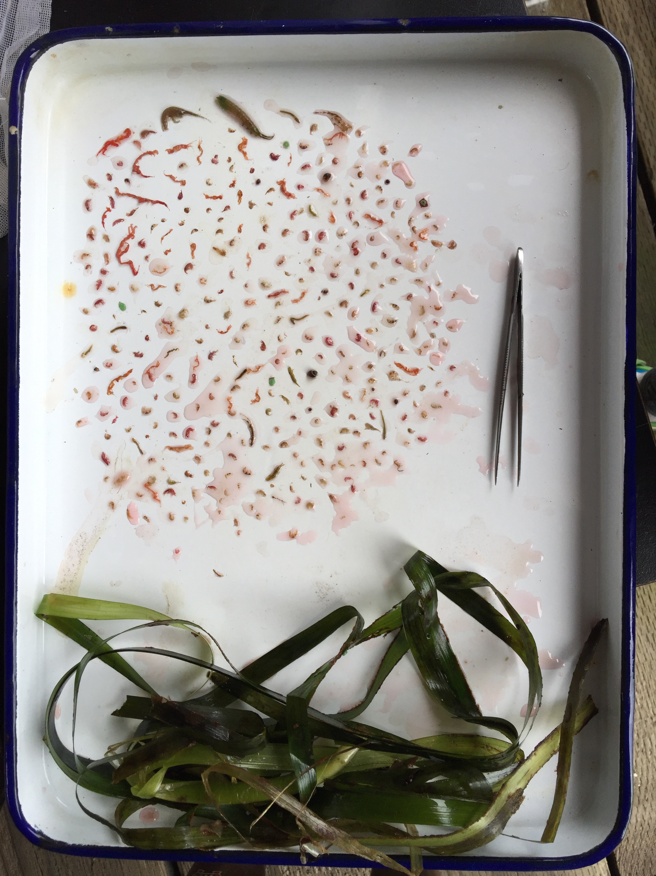
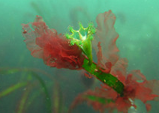
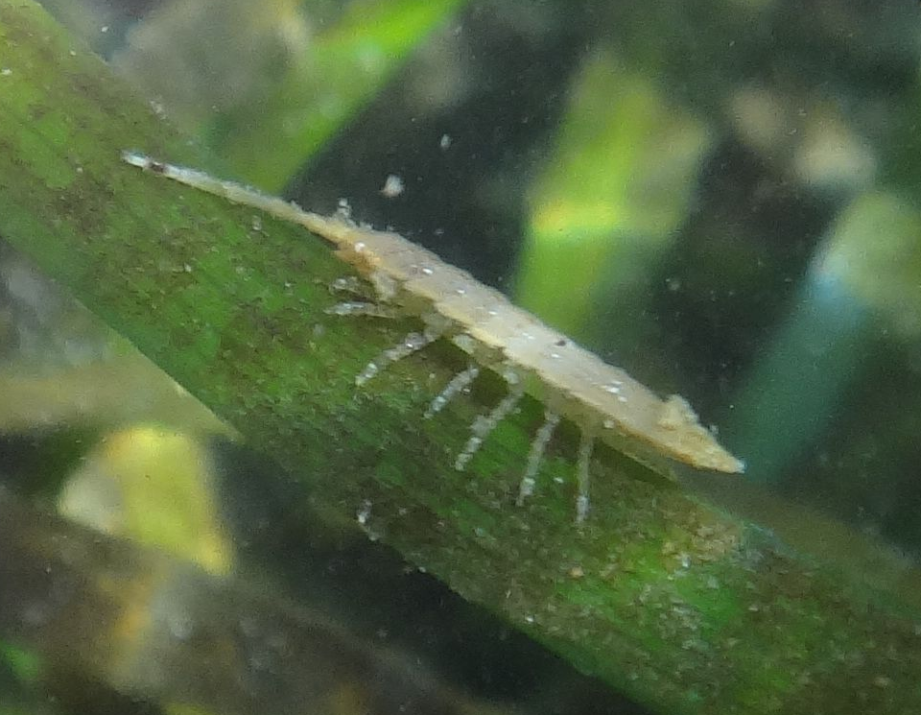
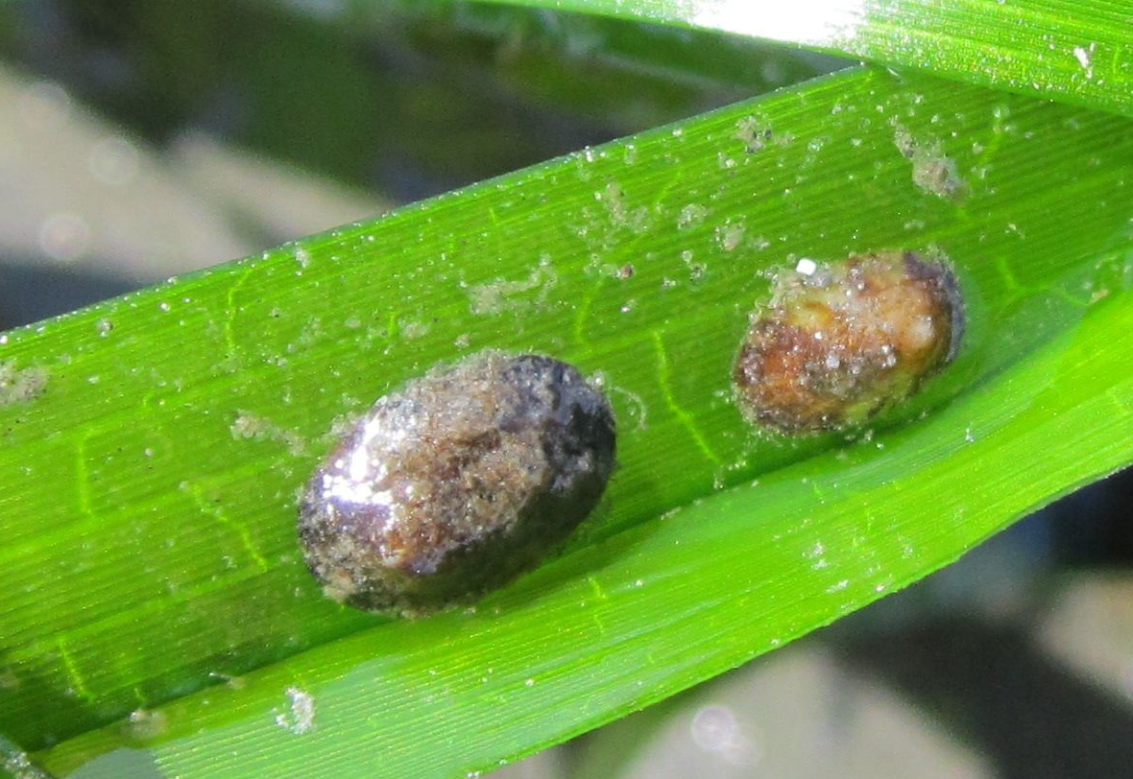
fish
Epiphytes
Grazers
Notes:
Birds, crabs, dogfish, wolfeels, sealions

Slide 3
What are the causes and consequences of biodiversity?
?
?
Forbes 2015
Notes:
What are the biotic/abiotic factors that influence community structure in seagrass meadow communities from the bottom up and top down?
Valentine and Heck 1993 MEPS 96: 63-74

